Slide 1
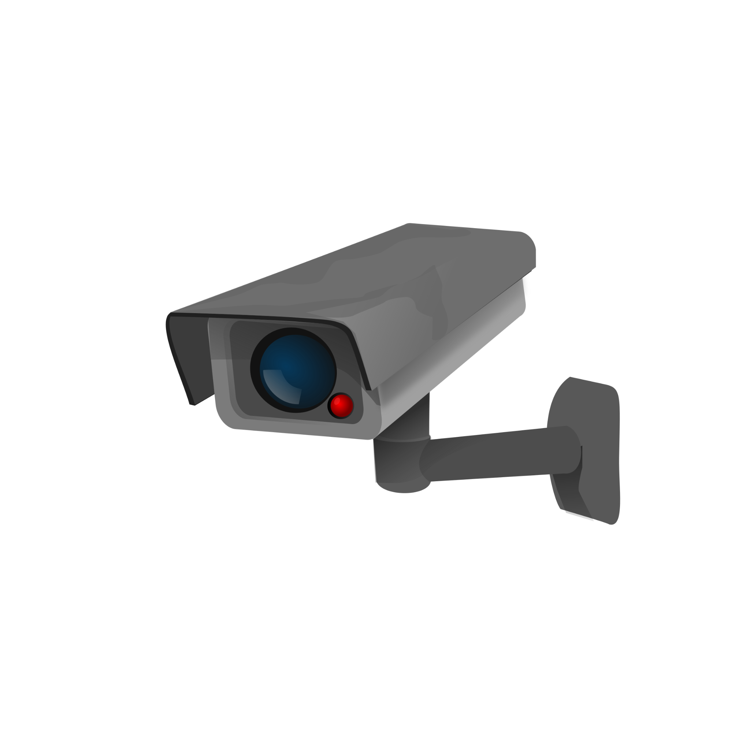

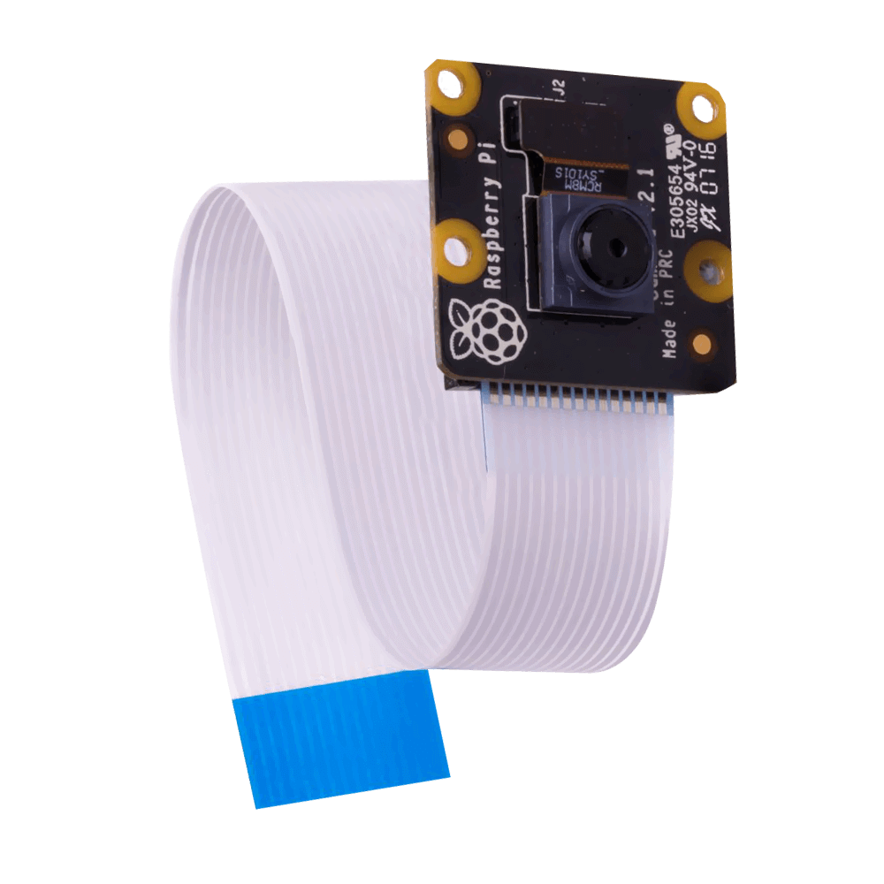
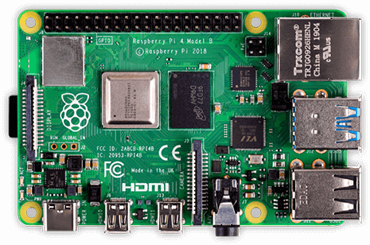


Visitor-Counter
Stefan Düx | Jessica Isabella Görög | Dominic Grabner | Rebekka Tscheppen | Lukas Varga
Visitor-Counter | Group 29 | BIF5 | Innovation Lab 3 | “the Observer”

Slide 2
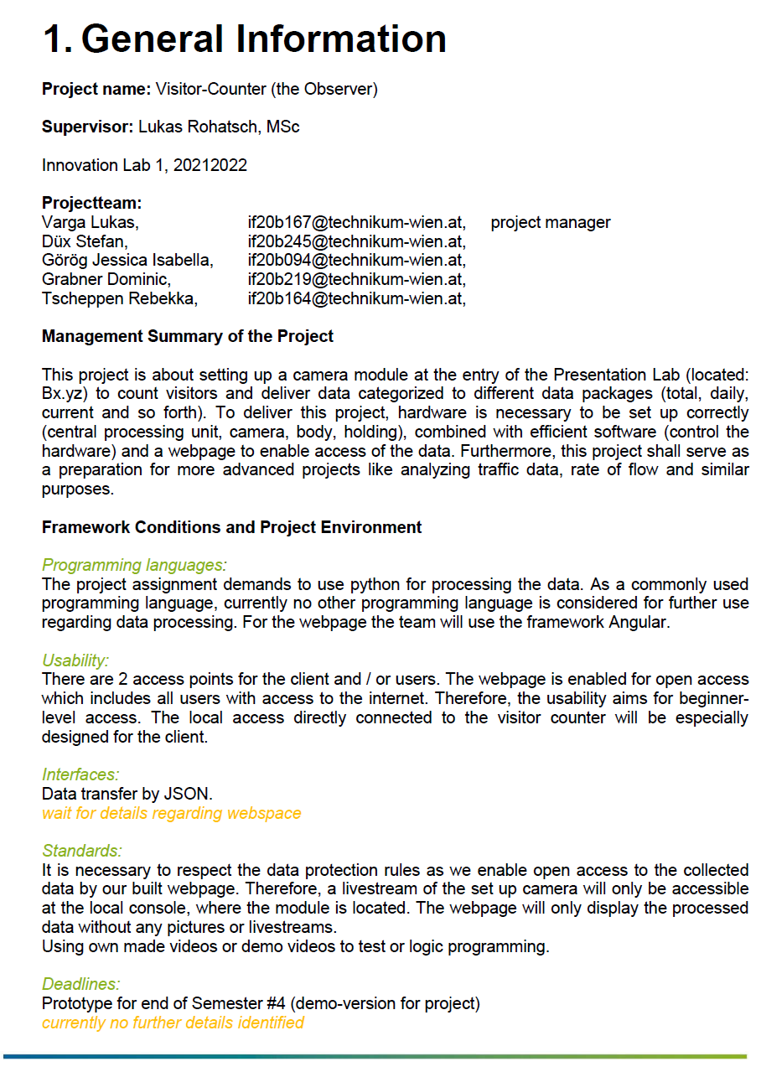
Description
data recording + analysis via raspberry pi 4 + camera module
person recognition to count visitors at Presentation Lab (FH Technikum)
adapted web-application and further data processing

Slide 3
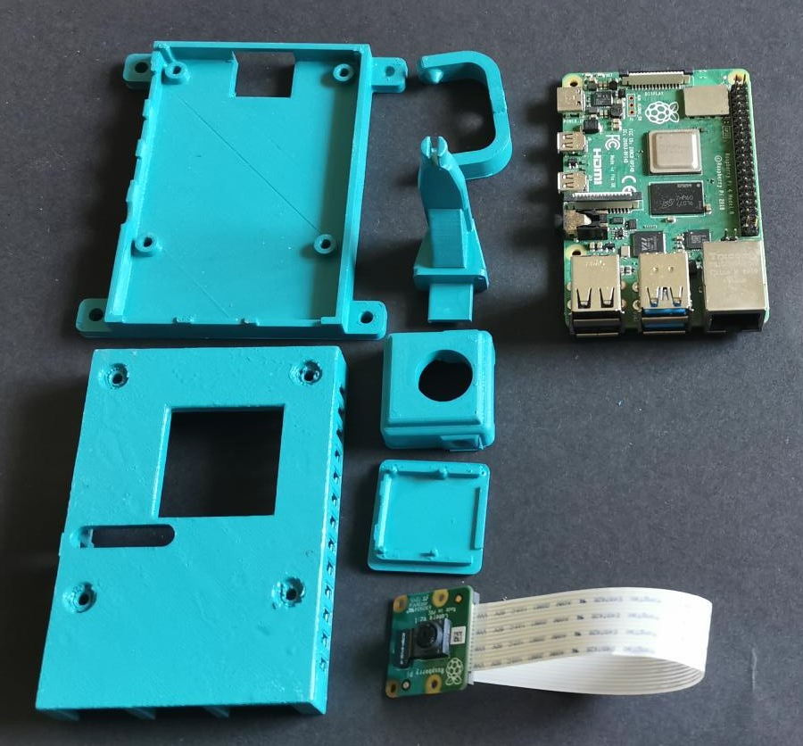
Hardware
Raspberry Pi 4B Computer (Raspberry Pi OS Lite) (Autostart)
Raspberry Pi Camera V2
3D printed case (Project Kitchen)
3D printed camera mount (Project Kitchen)

Slide 4
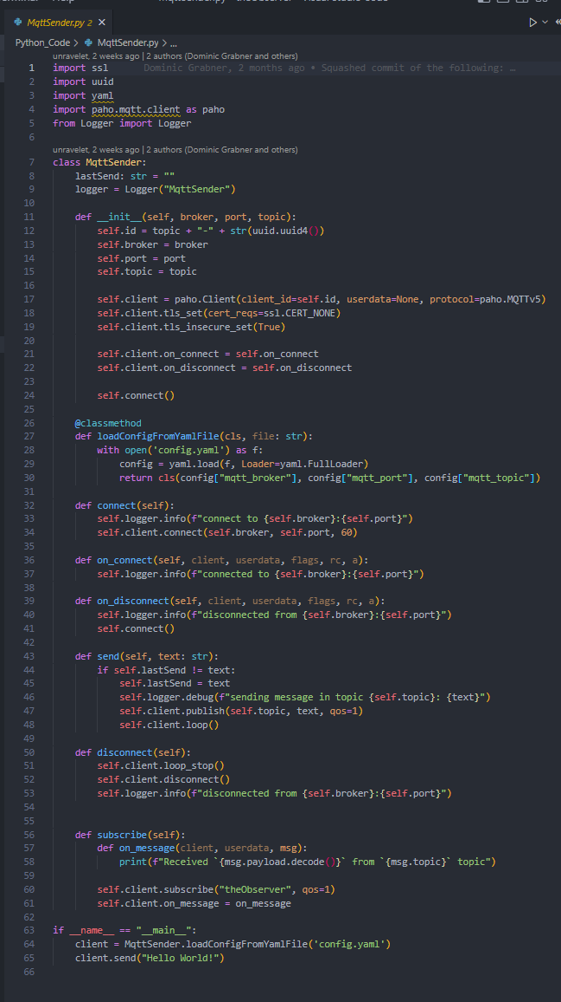
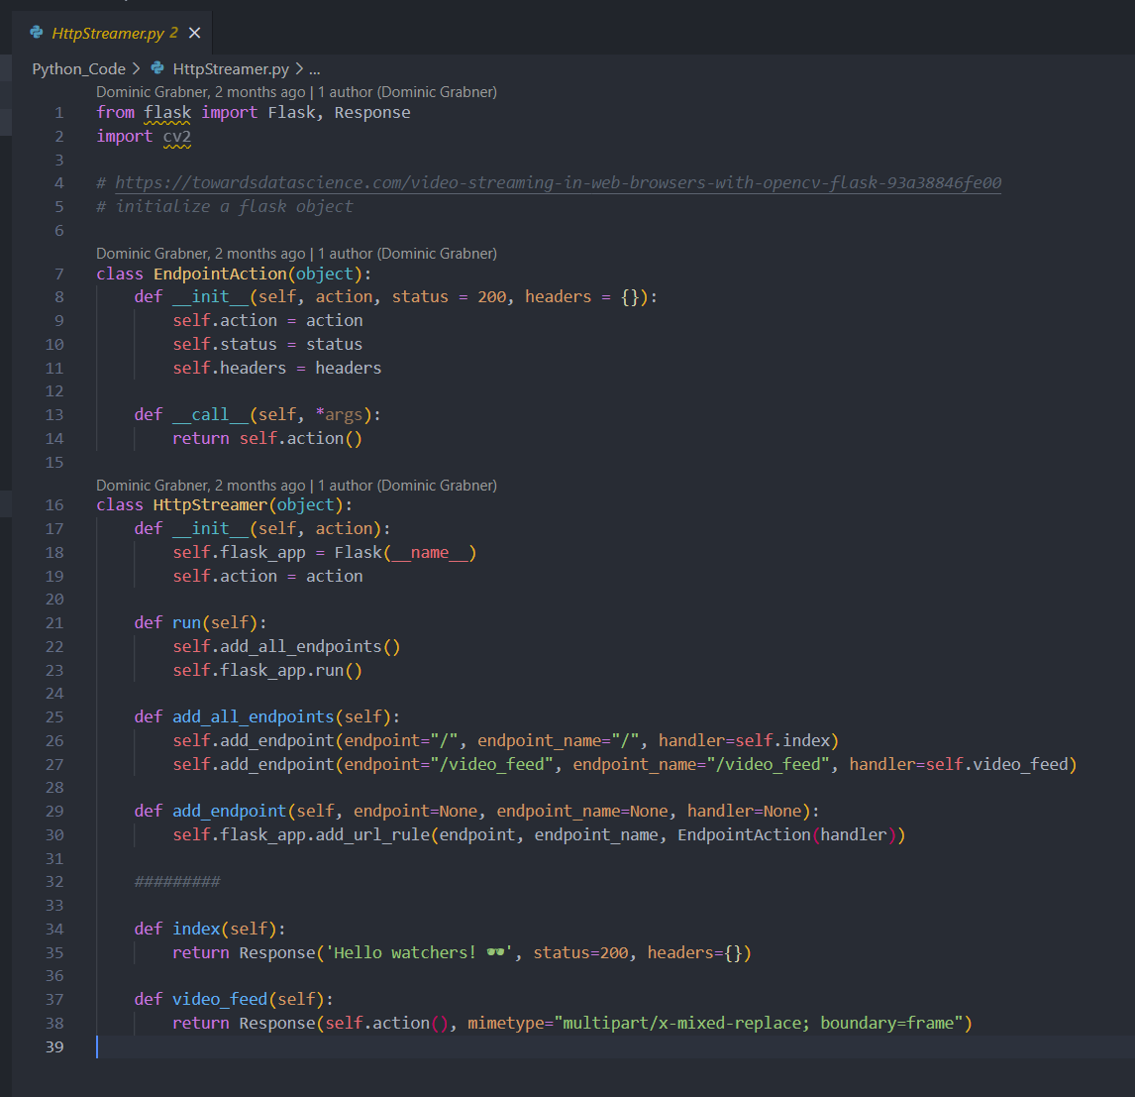
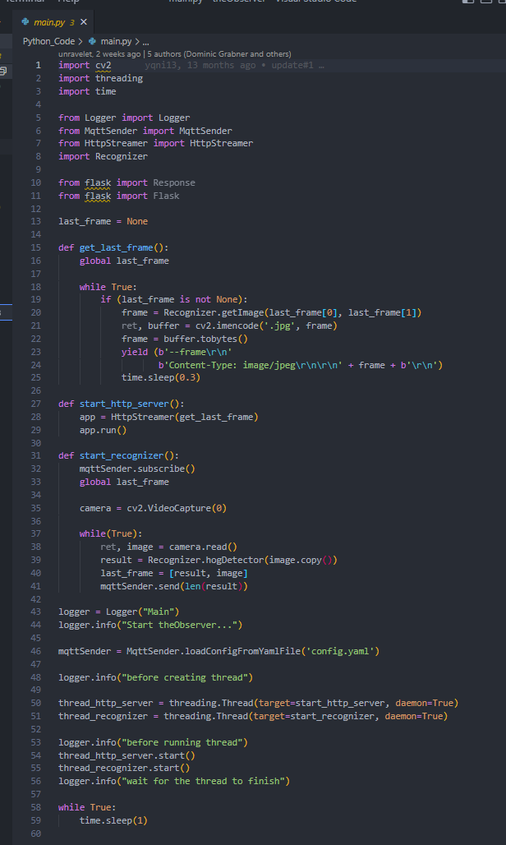
Code
class based programming (python)
openCV (image processing)
light ressources (2.5 fps)

Slide 5
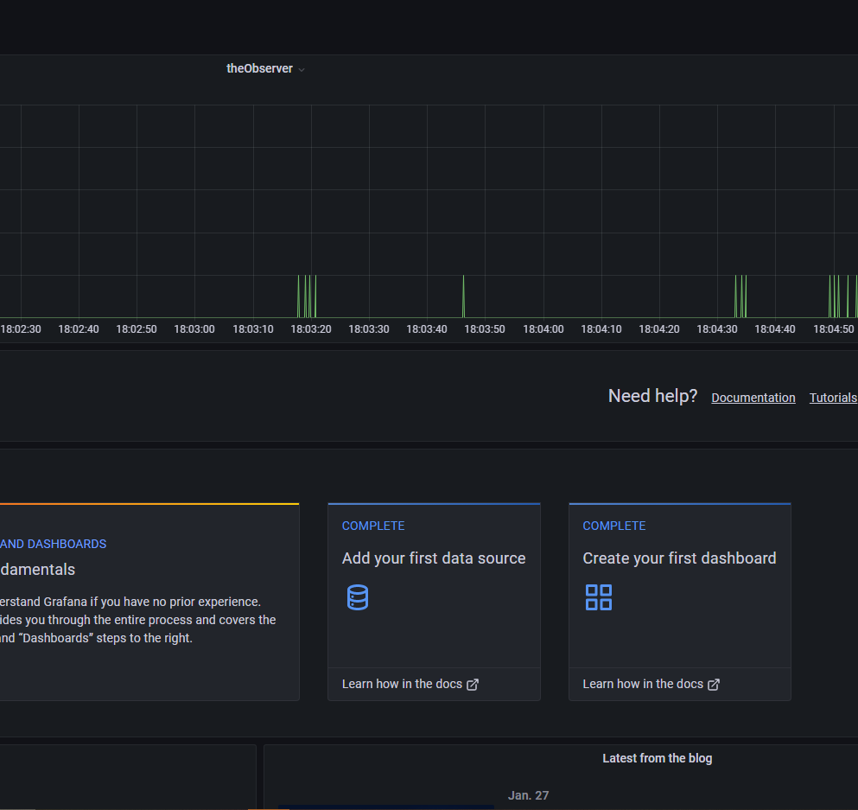
Data Access
mqtt (stream data)
Node-RED (transfers to db)
InfluxDB (Database)
Grafana (query/visualize data)

Slide 6
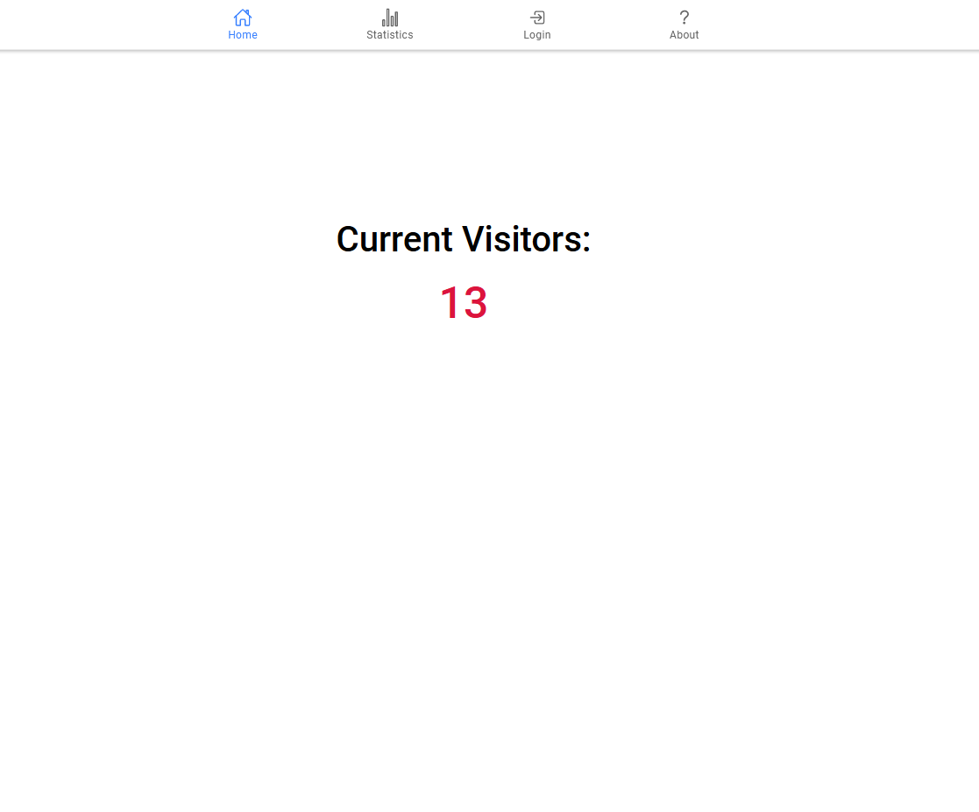
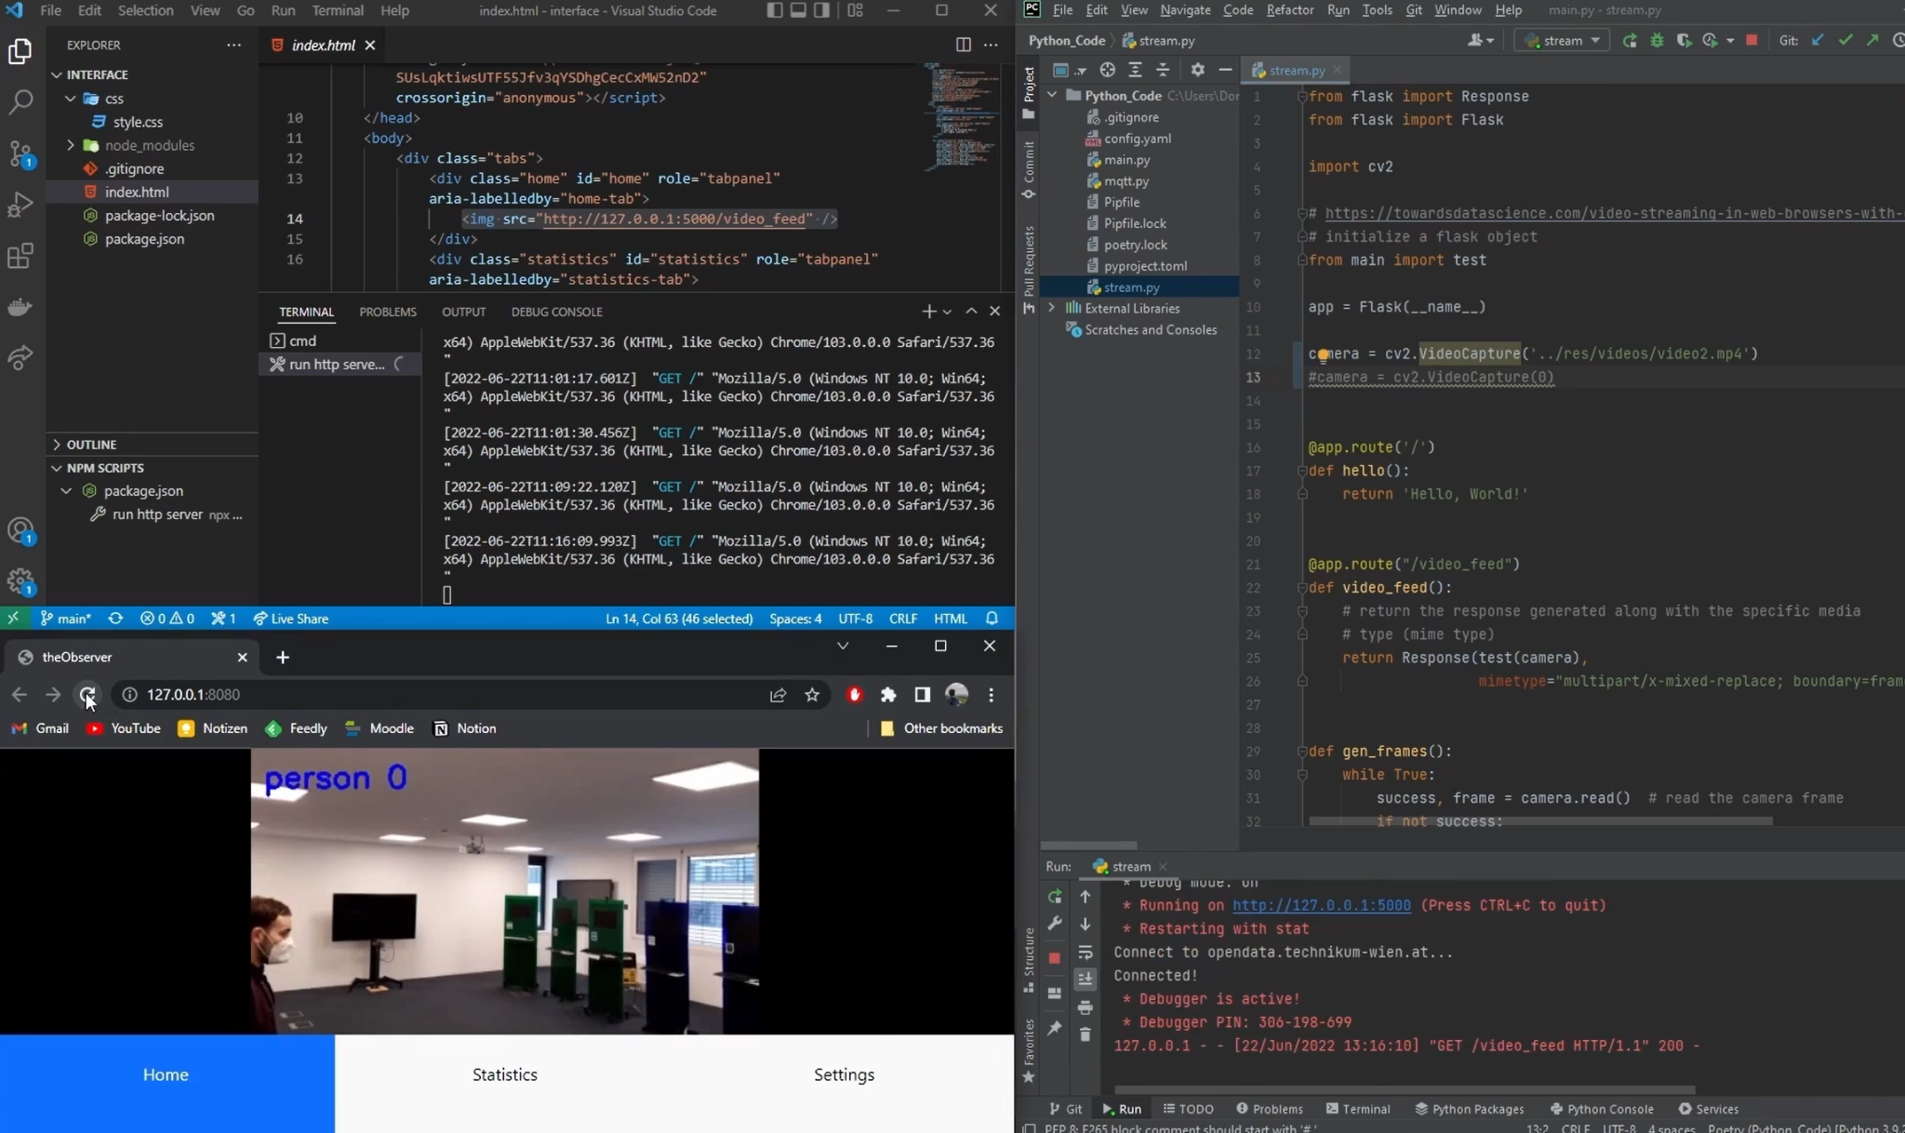
Webpage
Ionic / Angular (Framework)
open access (access data from internet)
prepared for livestream (interface option)

Slide 7
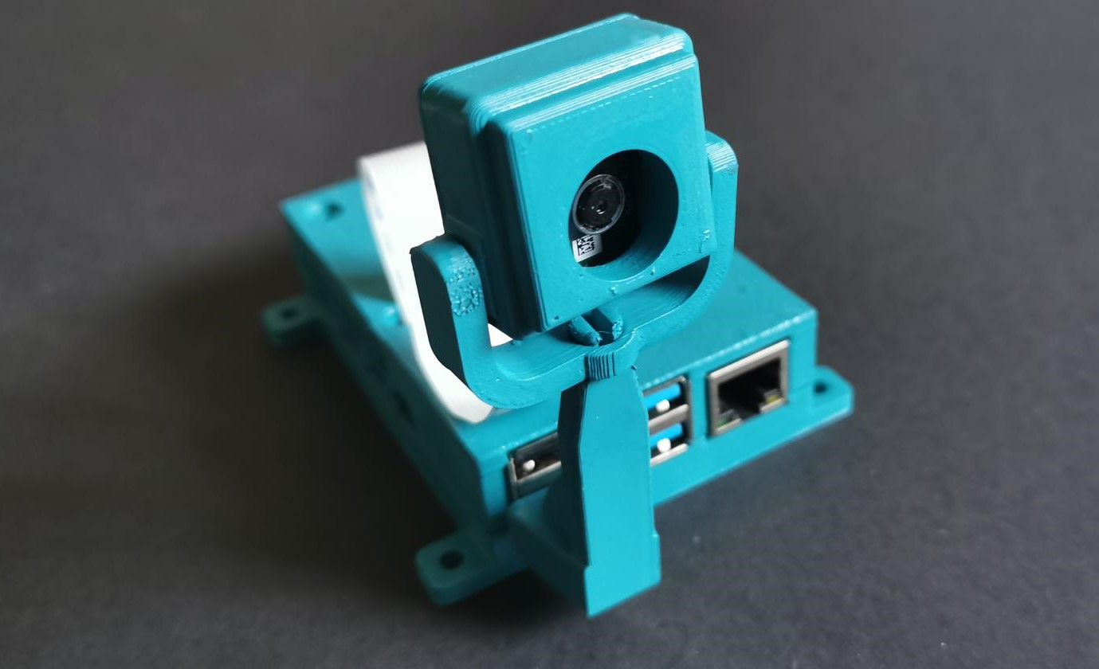
End of project.
3 semester duration
needs adapted host for new use-case
Stefan Düx | Jessica Isabella Görög | Dominic Grabner | Rebekka Tscheppen | Lukas Varga
Visitor-Counter | Group 29 | BIF5 | Innovation Lab 3 | “the Observer”

